Slide 1
Analysis of Guinness Sales in two Pubs in March 2019
Ed Keall

Slide 2
Premise
Two pubs in a town have similar high rates of sales of Guinness.
During mid March ‘19, one pub ran a St. Patricks day promotion while the other did not.
Two Pubs, a control and a sample/treatment

Slide 3
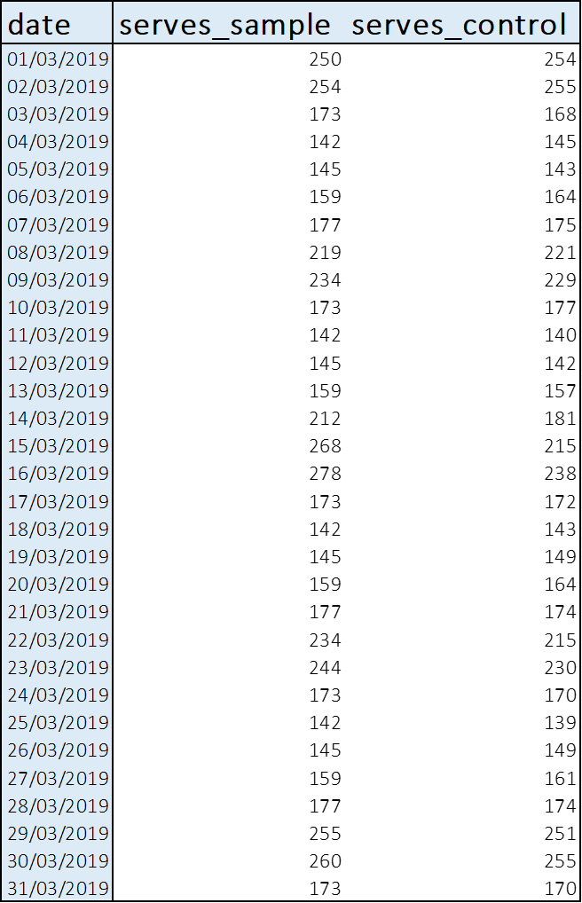
Aims
Explore the general March ‘19 trends in Guinness Sales of both pubs
Identify whether the St. Patrick's Day Promotion had a significant treatment effect on Guinness Sales
Notes:
NULL Hypothesis

Slide 4
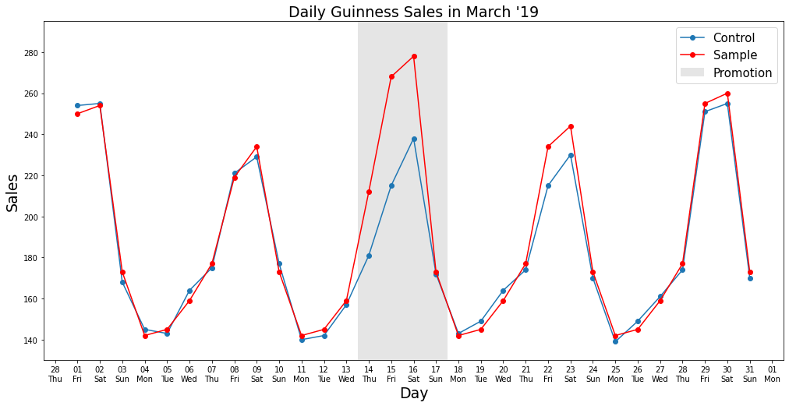
Trend Exploration

Slide 5
Trend Exploration
Clear Weekly Seasonality in both groups
Divergence between groups during promotion and after on weekends
Notes:
Clear Weekly Seasonality in both groups peaking on Fri/Sat and troughing at the start of every week
Divergence between groups during first 3 days of promotion and afterwards on friday/saturdays

Slide 6
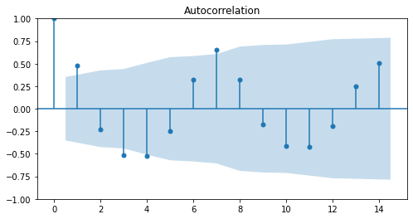
Trend Exploration - Autocorrelation
Weekly & Daily seasonal patterns
Notes:
Clear Weekly Seasonality in both groups peaking on Fri/Sat and troughing at the start of every week
Divergence between groups during first 3 days of promotion and afterwards on friday/saturdays

Slide 7
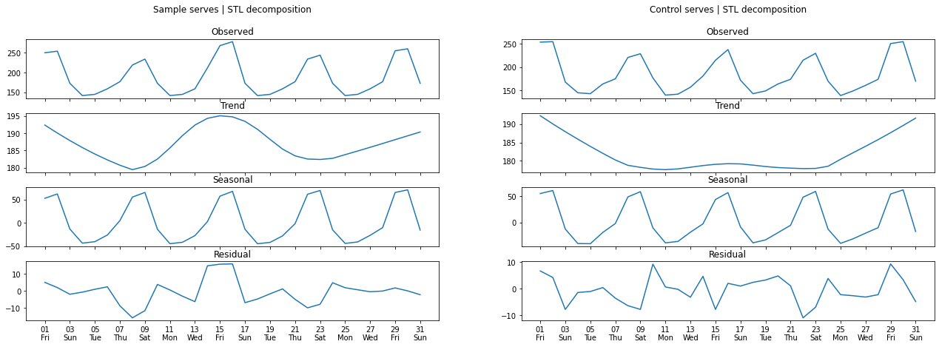
Trend Exploration - STL Decomposition
*Not comparable
Notes:
No anomalies in residuals

Slide 8
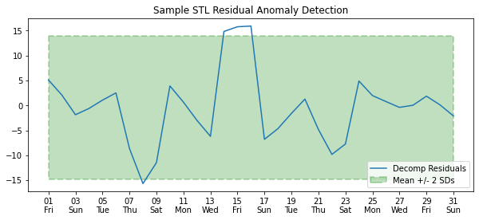
Treatment Effect - STL Robust Anomaly Detection
Expect 95% of results within +/-2SD
~10% of residuals during intervention period

Slide 9
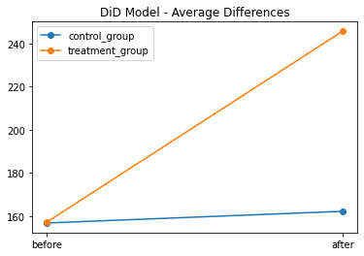
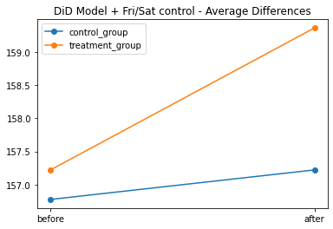
Treatment Effect - Difference in Difference (DiD) Model
1.
2.
It being a Friday or Saturday significantly impacts Guinness Sales in both Pubs
No interactions between any groups in these models

Slide 10
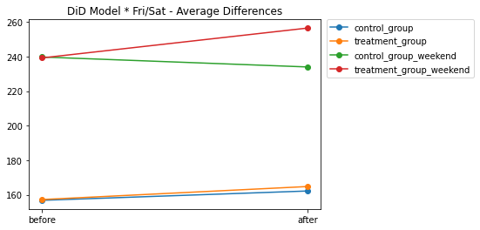
Treatment Effect - Difference in Difference Regression Model
3.
No significant interactions between any variables in the model

Slide 11
Conclusions
The treatment explains positive anomaly Guinness sales in the treatment group
Reliable estimation of treatment effect could not be obtained through use of a difference in difference regression model

Slide 12
Evaluation
Improvements to DiD Model:
3 period groups (Before/During/After interaction)
Modelling of Seasonality to replace Fri/Sat Dummy variable
Further sample data could facilitate the use of intervention ARIMA modelling techniques
Notes:
Arima - accurate monthly trend

